Slide 1
REPORT ABOUT CONTRIBUTE BACK TO OPEN SOURCE
Instructor: Thai Minh Tuan
Nguyen Minh Nhut - B2205896 & Huynh Tan Dat - B2203438

Slide 2
Contents
Repository | Issues
PNW-CS-Club/Club-Website | Update Homepage with Filler #20
TheBaljitSingh/chrome-extension-for-linkedin-messaging | fix this: currently at Homepage when I click on message Box it is not working. But direct going through link it is working #1
ufosc/Club-Manager | Available Clubs Page #24

Slide 3
Repository | Issues
PNW-CS-Club/Club-Website | Update Homepage with Filler #20

Slide 4
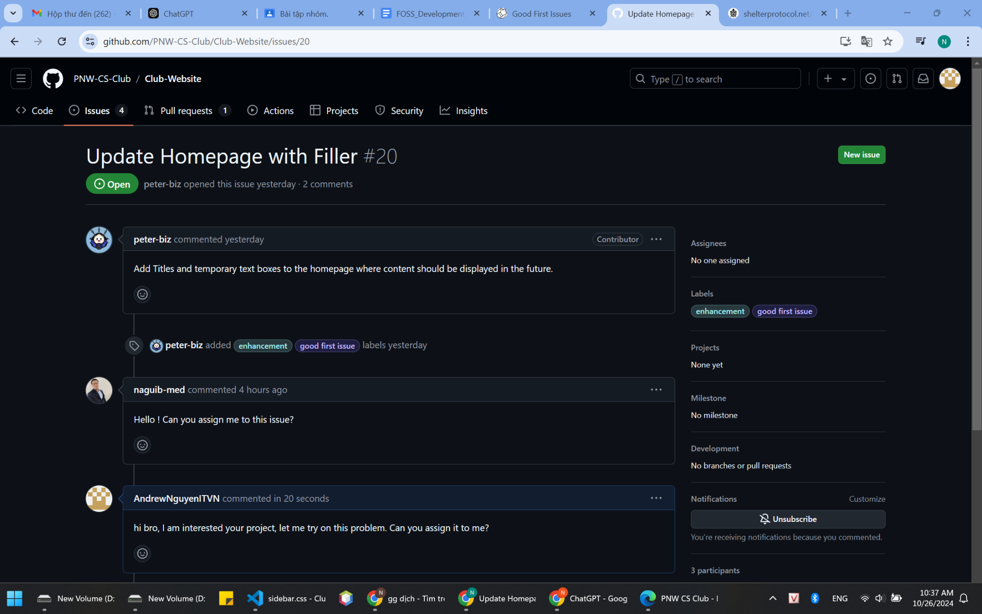
Update Homepage with Filler #20
Read the issue description

Slide 5
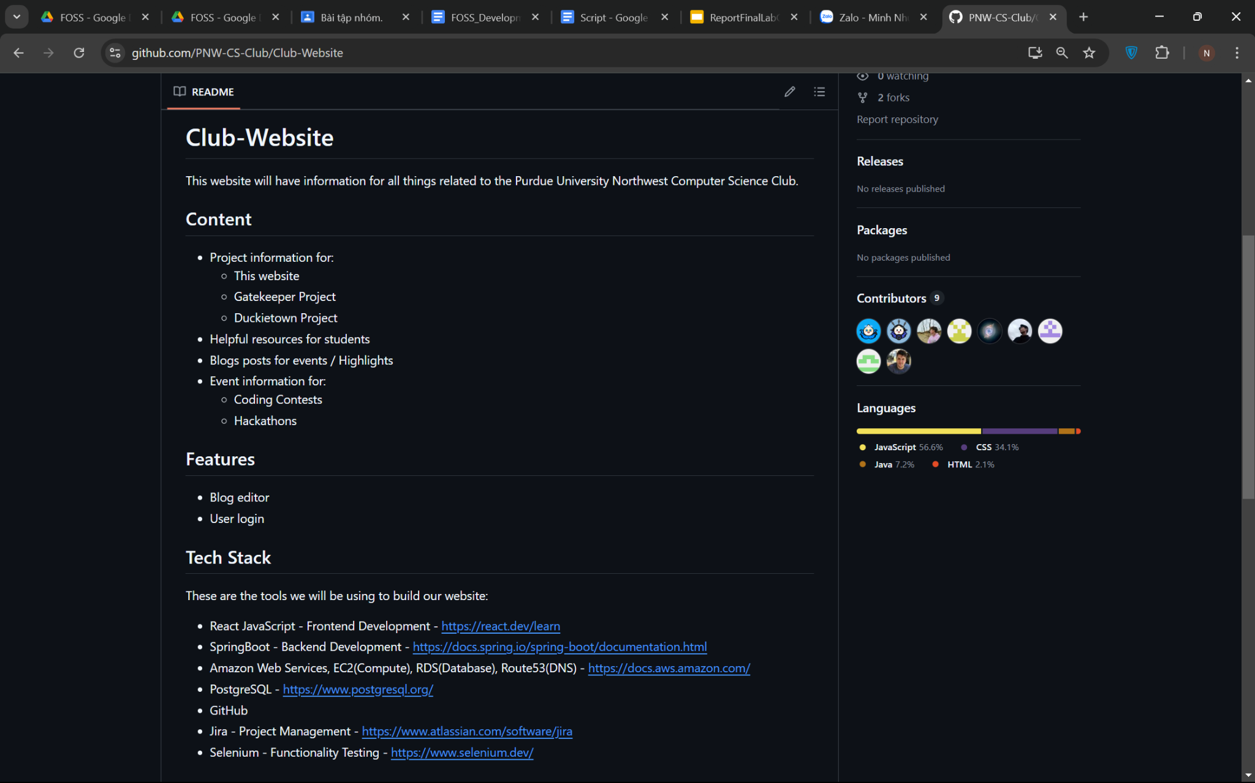
Update Homepage with Filler #20
Investigate the project and review the README

Slide 6
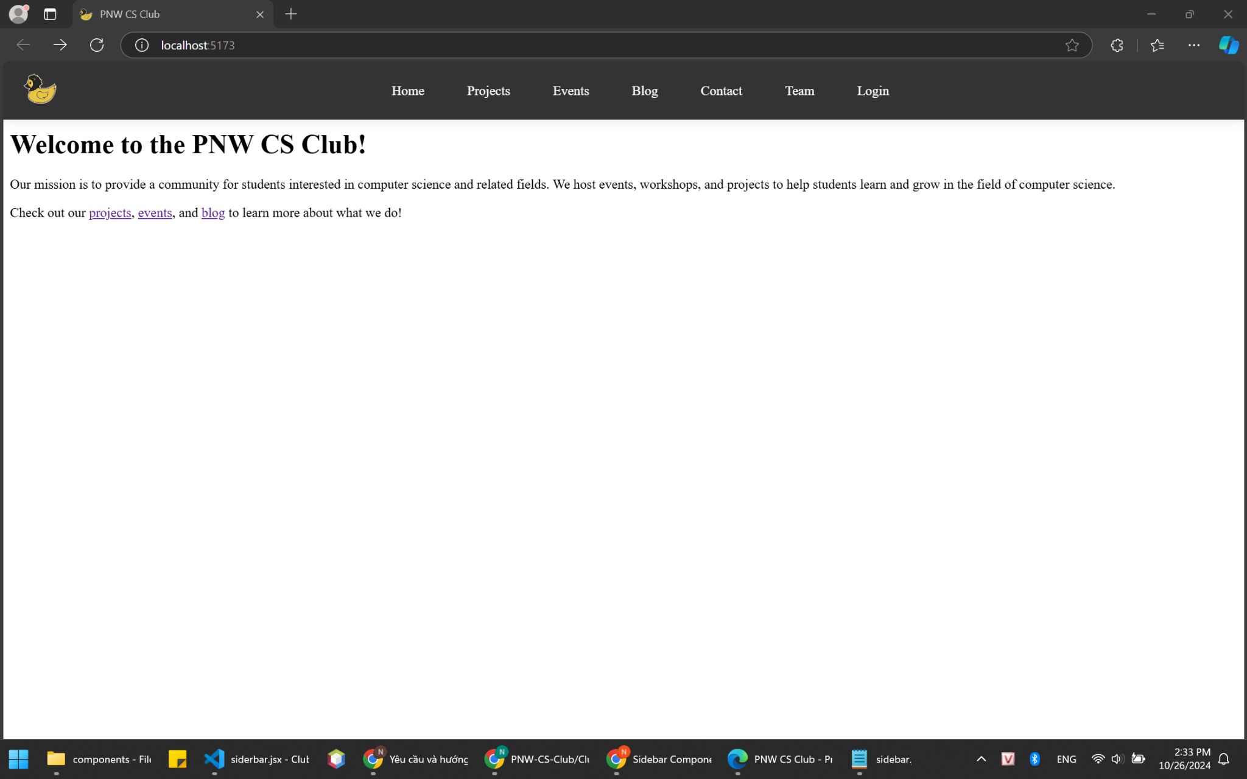
Update Homepage with Filler #20
The original homepage

Slide 7
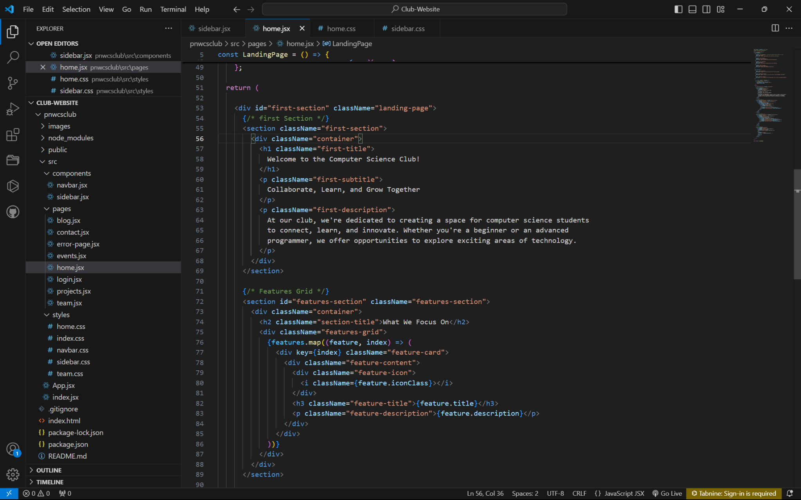
Update Homepage with Filler #20
Add content of home.jsx for the project

Slide 8
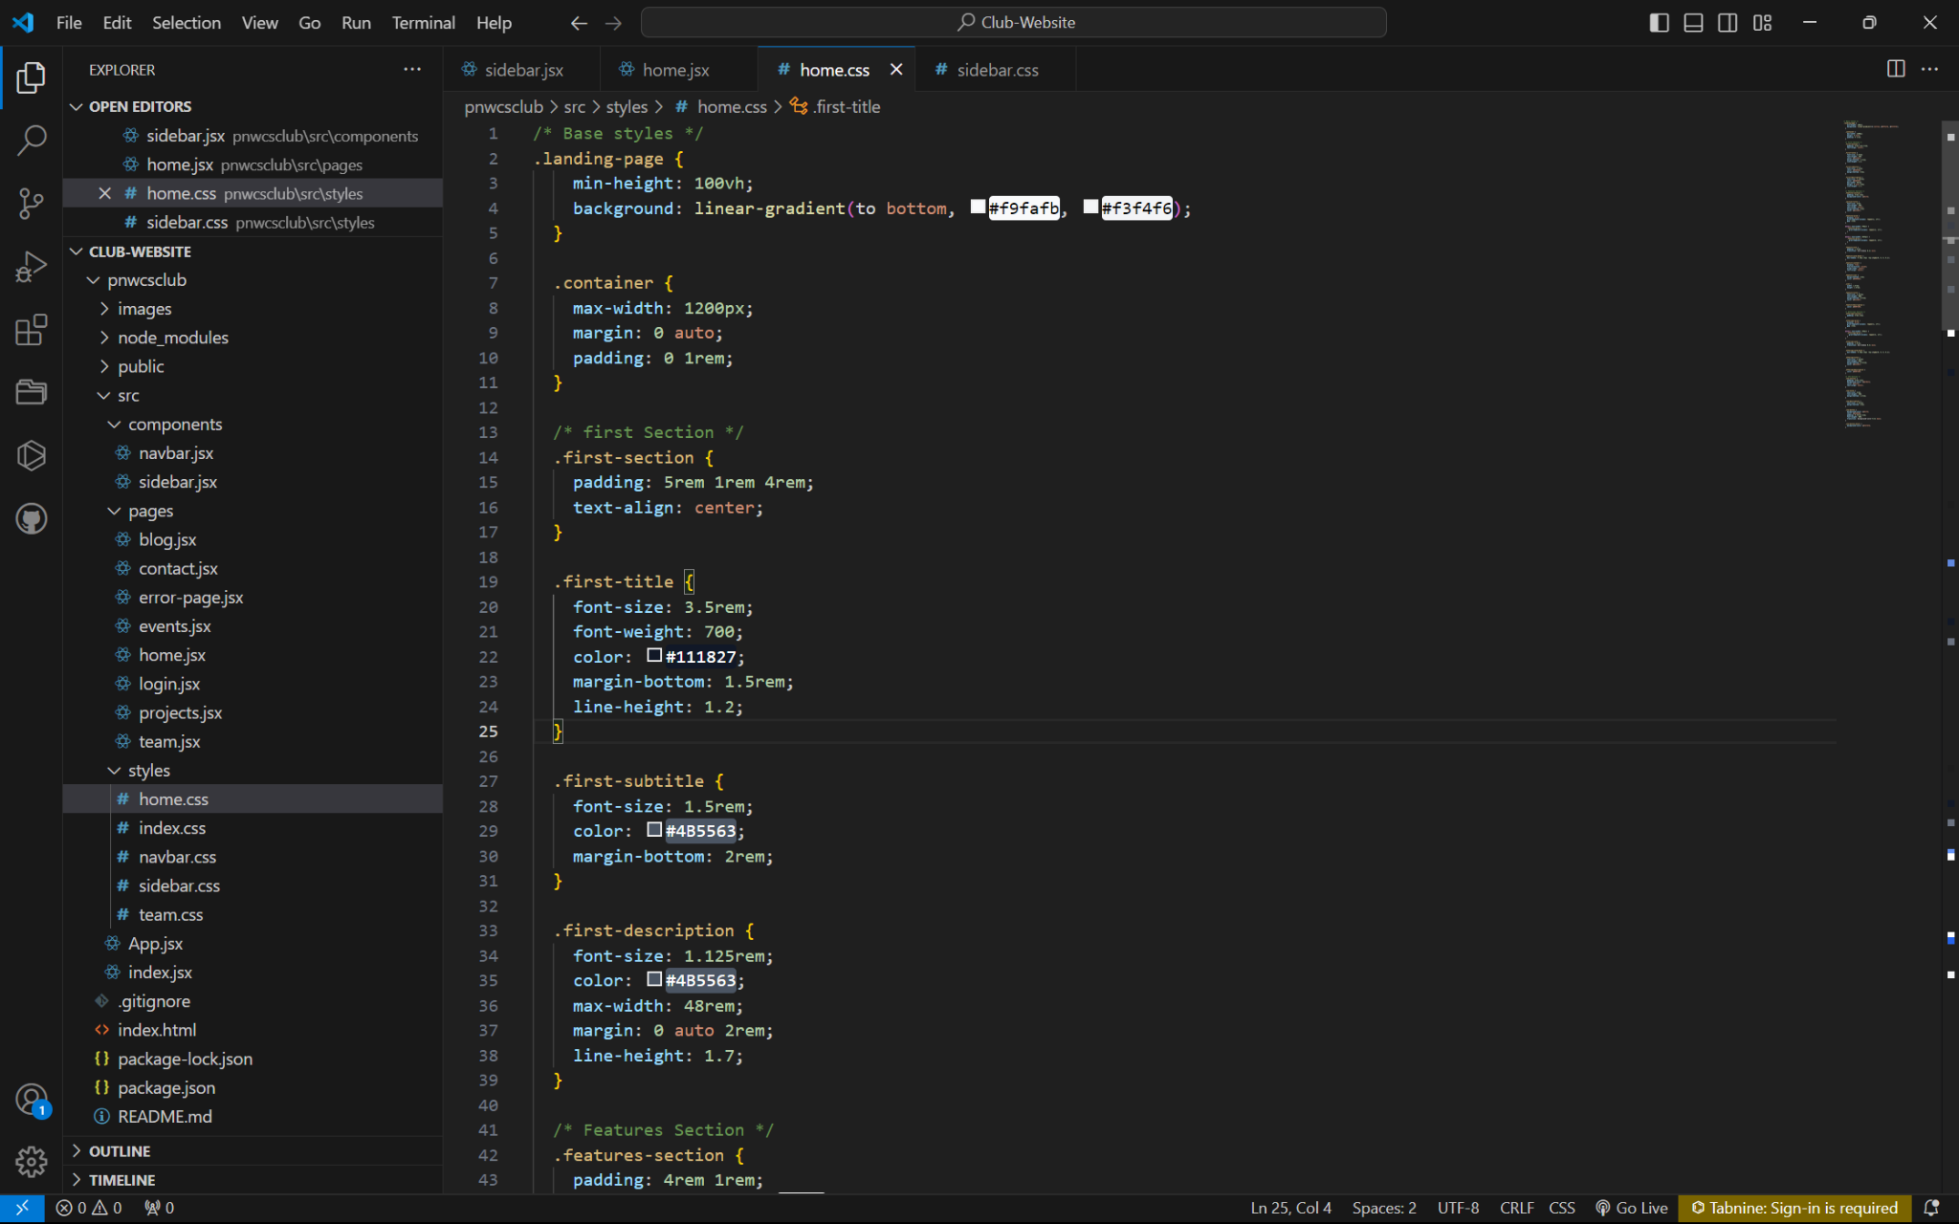
Update Homepage with Filler #20
Add CSS for homepage

Slide 9
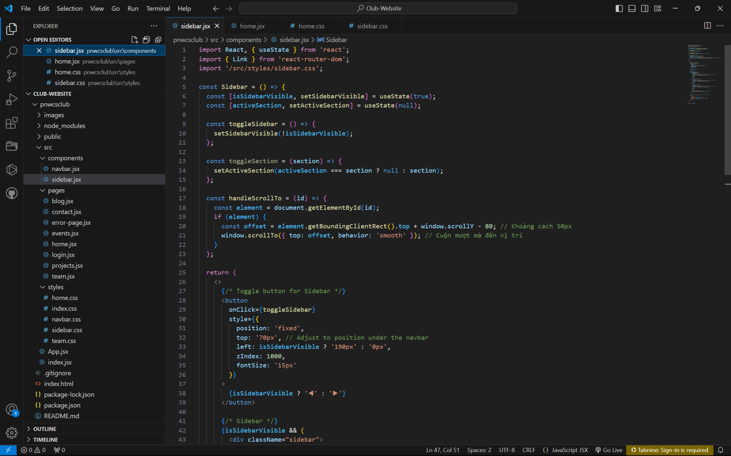
Update Homepage with Filler #20
Add for them a sidebar

Slide 10
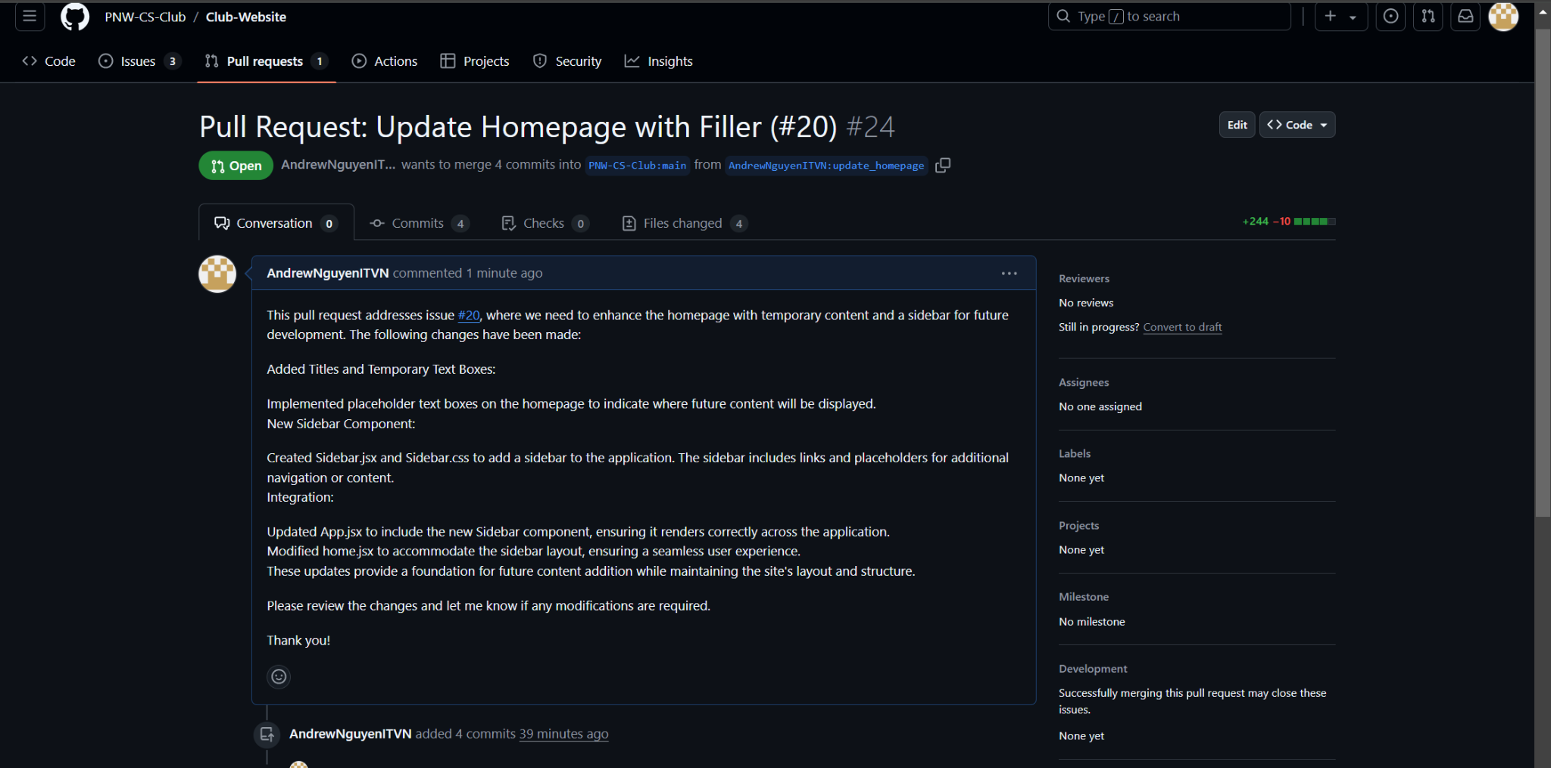
Update Homepage with Filler #20
Commit and create a pull request for the maintainer

Slide 11
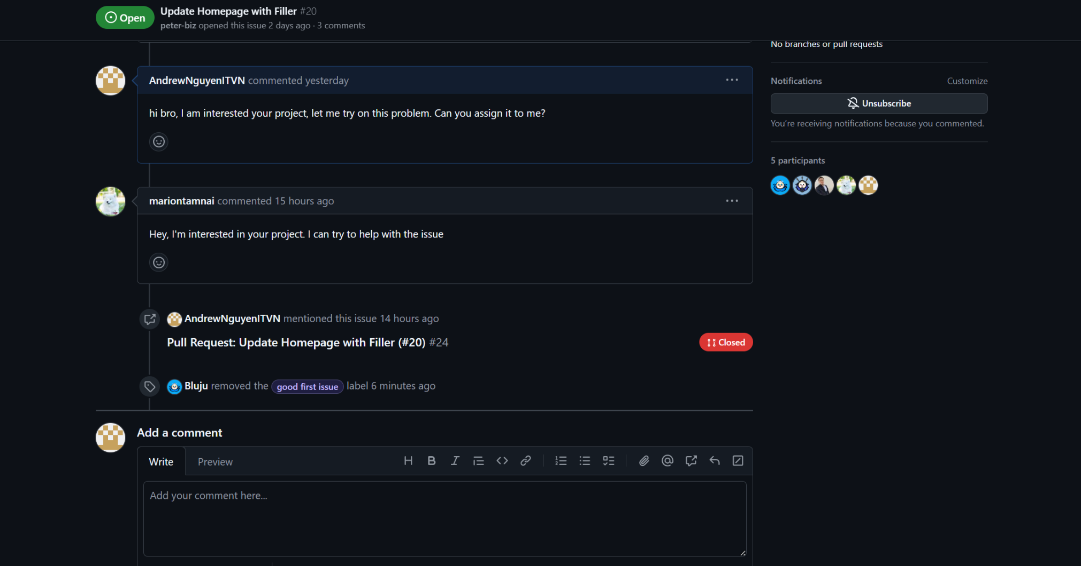
Update Homepage with Filler #20
Rusult of the contribution of the issue

Slide 12
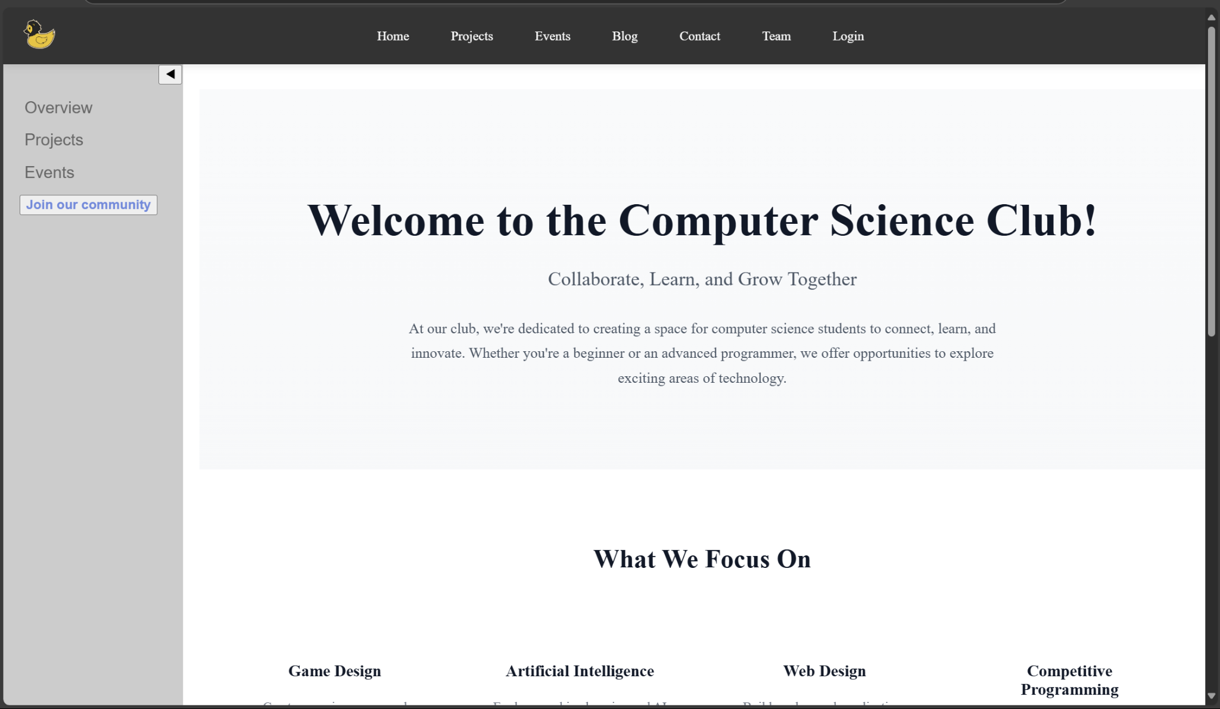
Update Homepage with Filler #20
The homepage after update

Slide 13
Repository | Issues
TheBaljitSingh/chrome-extension-for-linkedin-messaging | fix this: currently at Homepage when I click on message Box it is not working. But direct going through link it is working #1

Slide 14
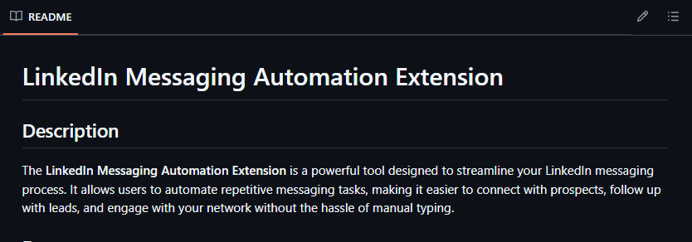
fix this: currently at Homepage when I click on message Box it is not working. But direct going through link it is working #1
Review README file

Slide 15
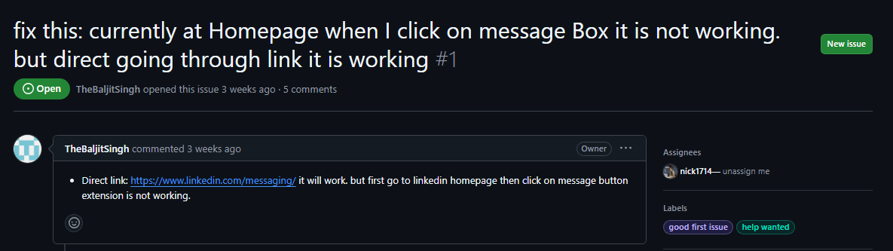
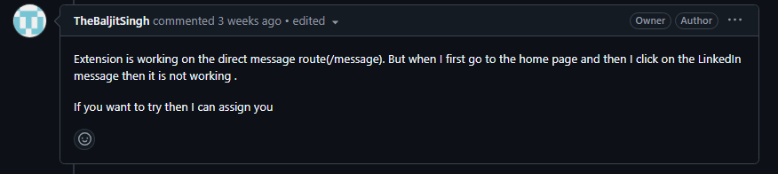
fix this: currently at Homepage when I click on message Box it is not working. But direct going through link it is working #1
Bug in the extension

Slide 16
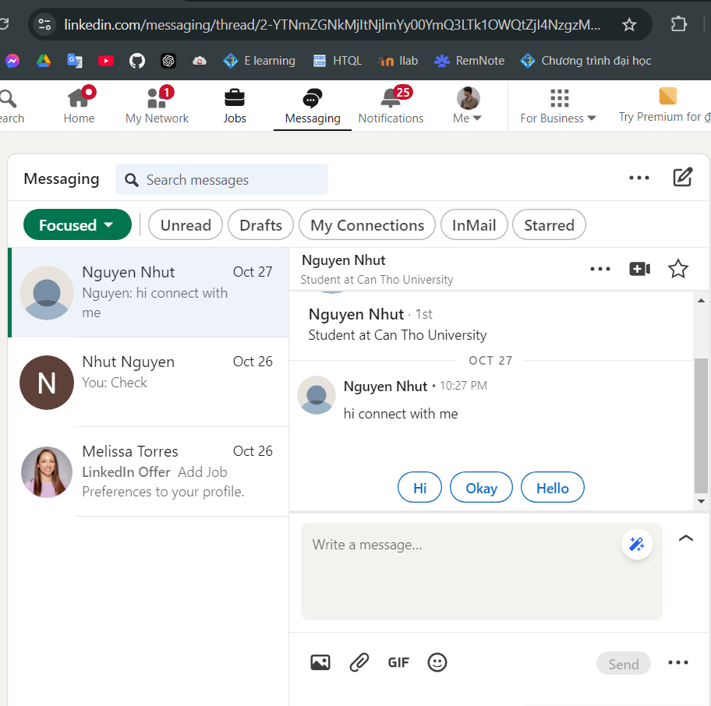
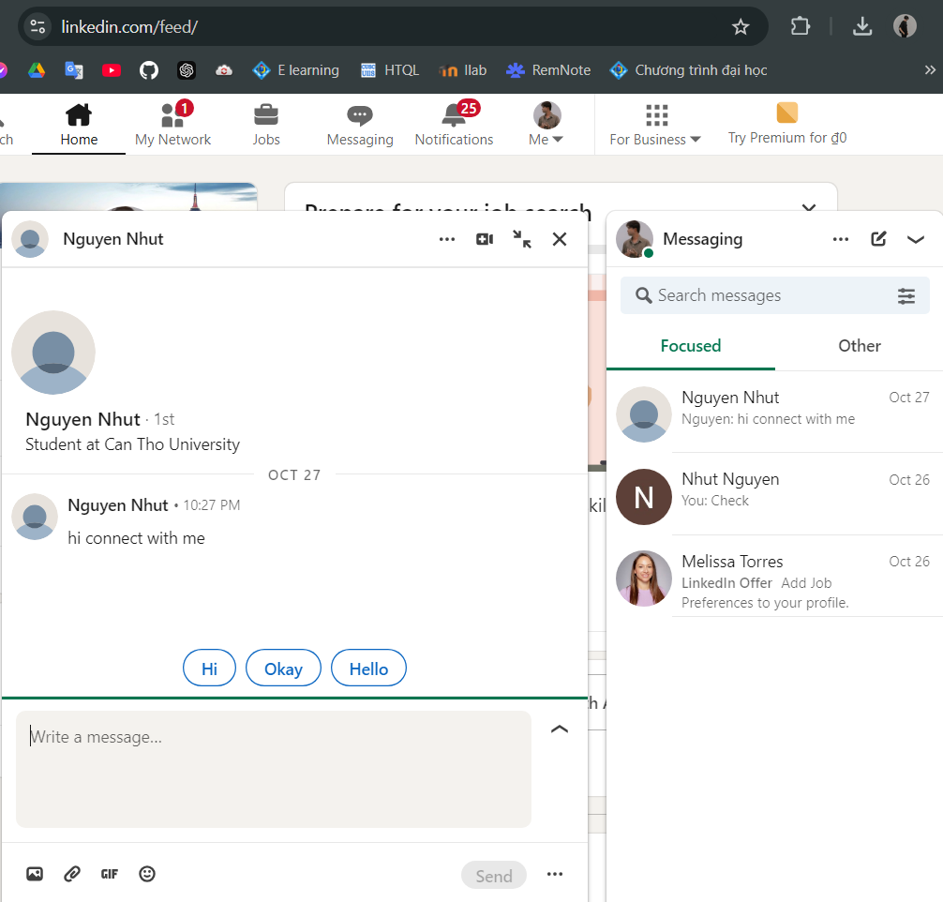
fix this: currently at Homepage when I click on message Box it is not working. But direct going through link it is working #1
Bug in the extension
?

Slide 17
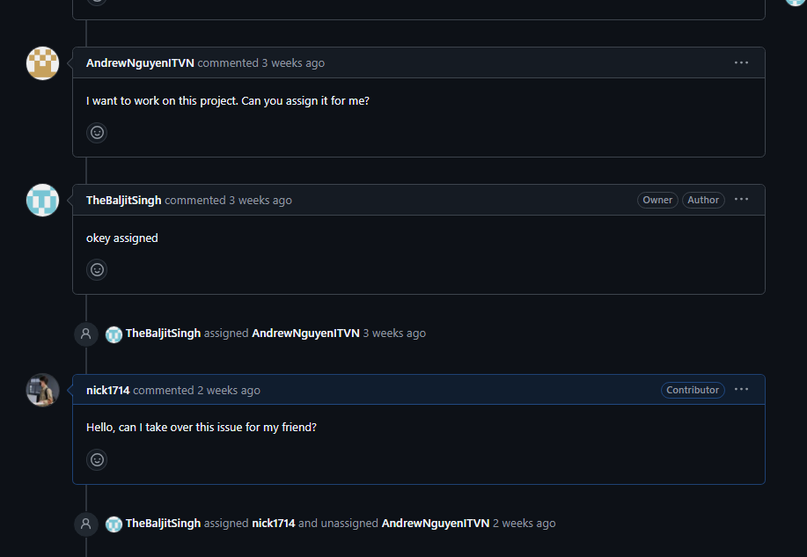
fix this: currently at Homepage when I click on message Box it is not working. But direct going through link it is working #1
Assign the issue

Slide 18
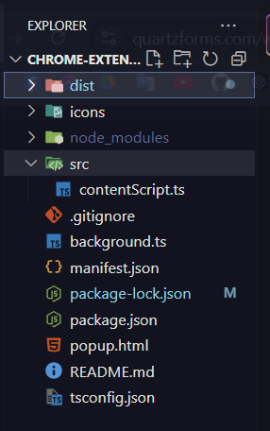
fix this: currently at Homepage when I click on message Box it is not working. But direct going through link it is working #1
Two problem in two file in the extension

Slide 19
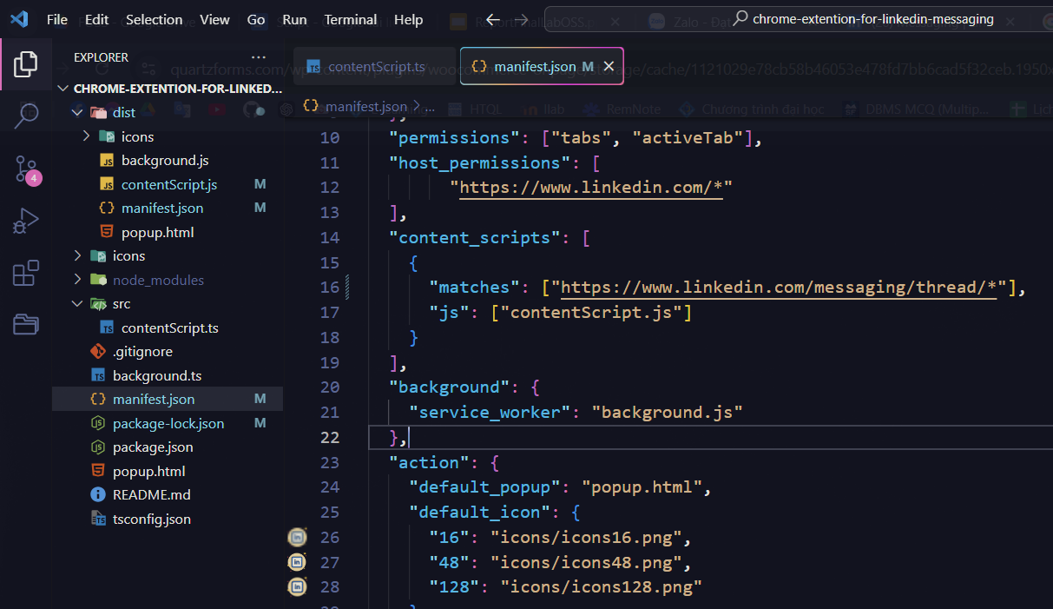
fix this: currently at Homepage when I click on message Box it is not working. But direct going through link it is working #1
In manifest.json file

Slide 20
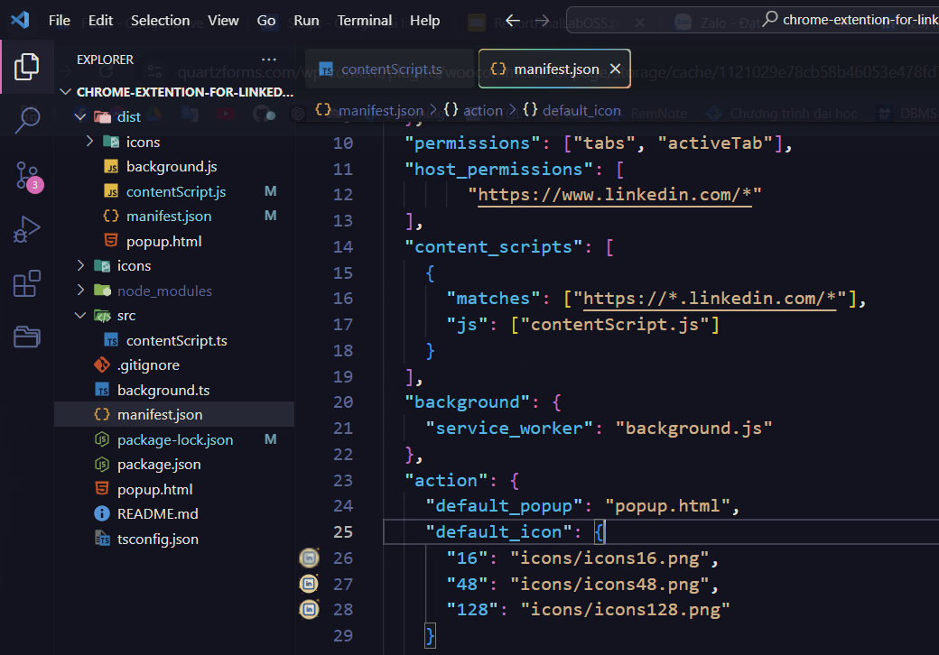
fix this: currently at Homepage when I click on message Box it is not working. But direct going through link it is working #1
Fix in manifest.json file
BEFORE
AFTER

Slide 21
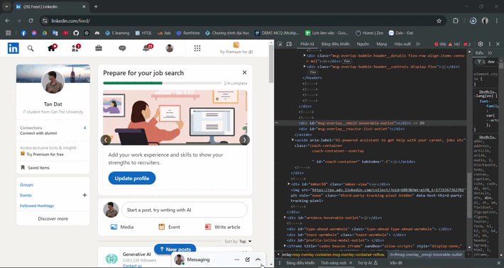
fix this: currently at Homepage when I click on message Box it is not working. But direct going through link it is working #1
Dynamic class

Slide 22
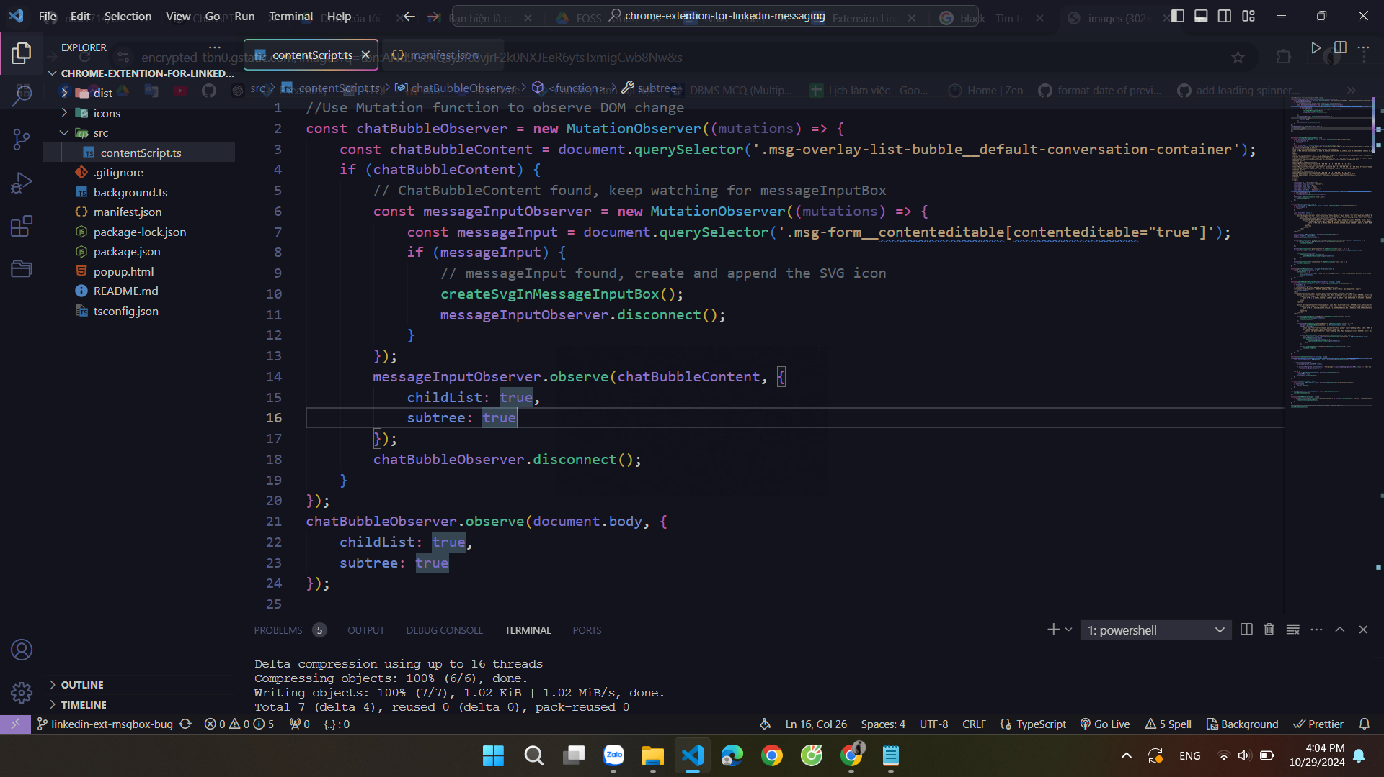
fix this: currently at Homepage when I click on message Box it is not working. But direct going through link it is working #1
Fix in contentScript.ts file

Slide 23
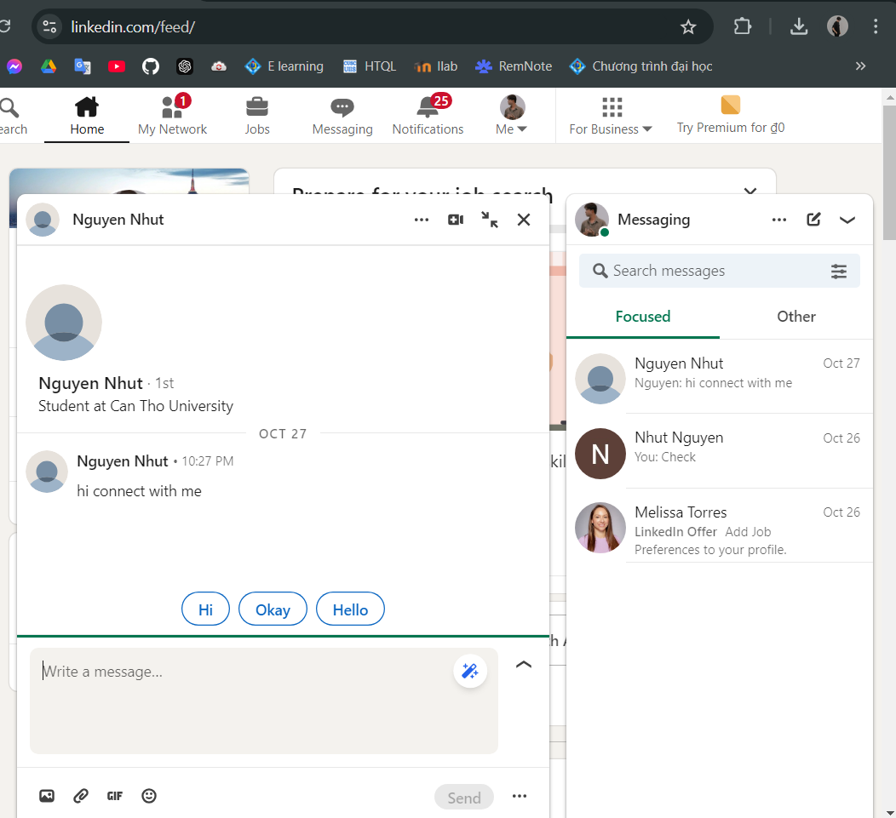
fix this: currently at Homepage when I click on message Box it is not working. But direct going through link it is working #1
Rebuild and check the result

Slide 24
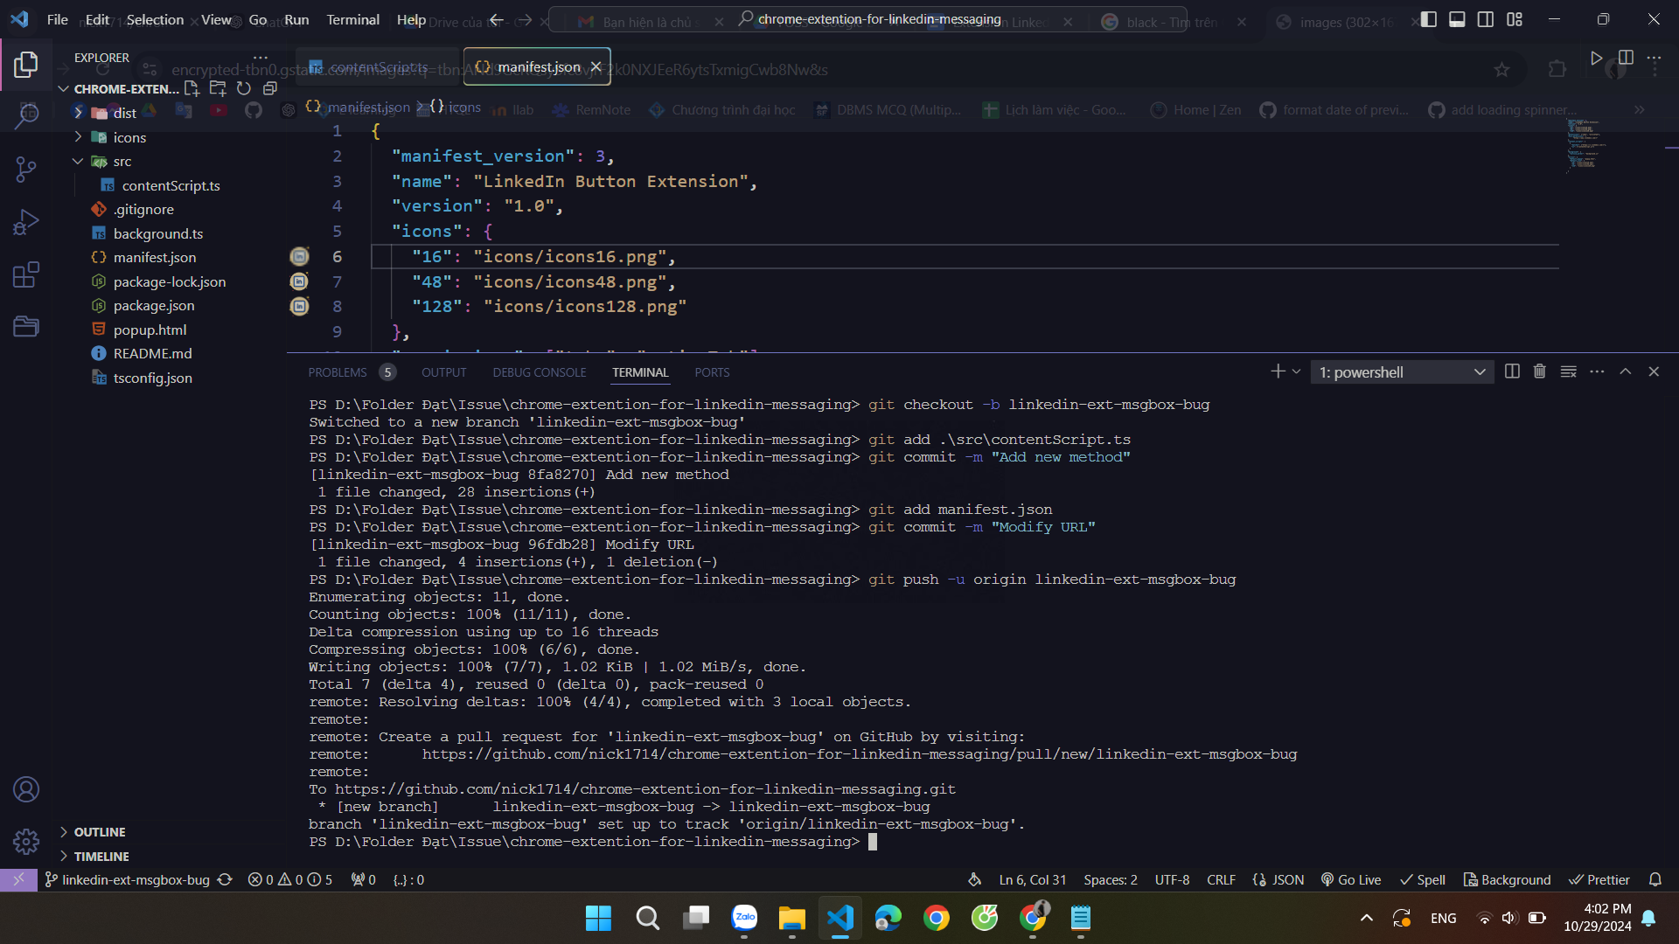
fix this: currently at Homepage when I click on message Box it is not working. But direct going through link it is working #1
Push to new branch

Slide 25
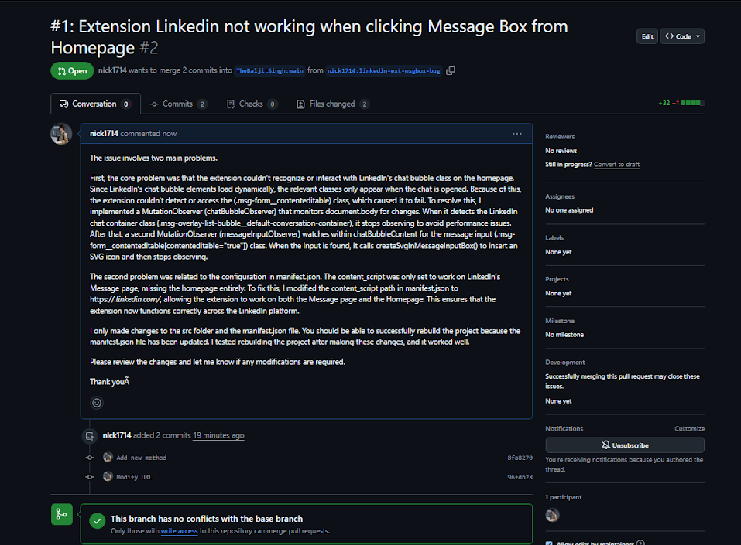
fix this: currently at Homepage when I click on message Box it is not working. But direct going through link it is working #1
Create a Pull Request

Slide 26
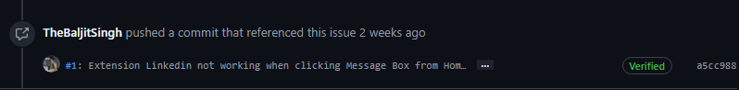
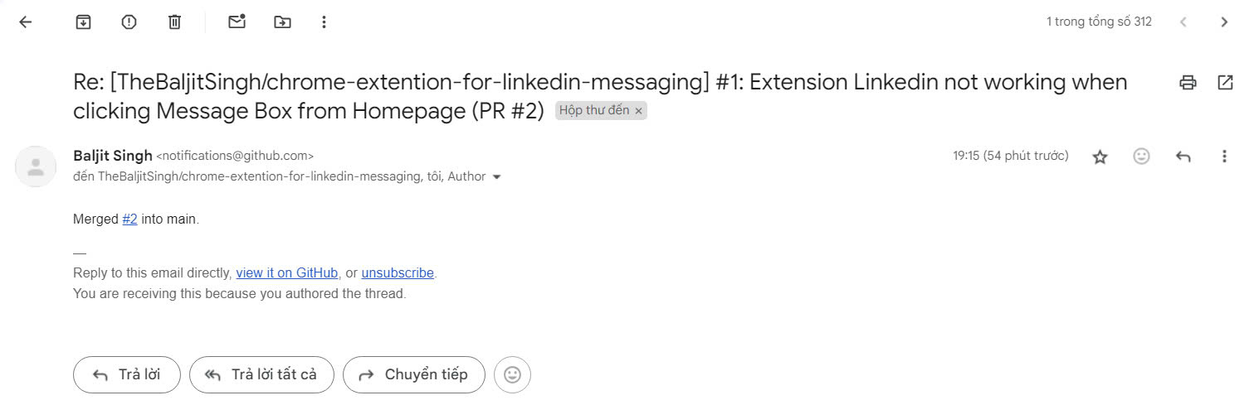
fix this: currently at Homepage when I click on message Box it is not working. But direct going through link it is working #1
Merge to the main repository

Slide 27
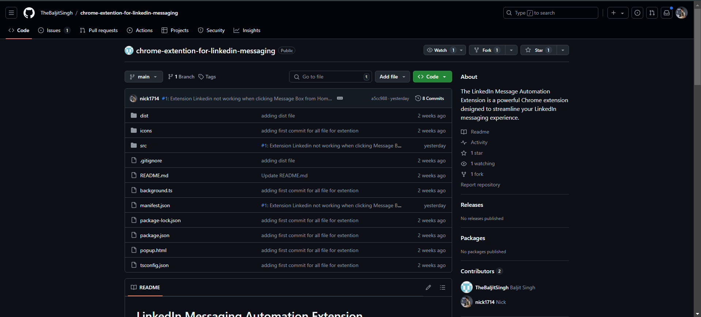
fix this: currently at Homepage when I click on message Box it is not working. But direct going through link it is working #1
Merge to the main repository

Slide 28
Repository | Issues
ufosc/Club-Manager | Available Clubs Page #24

Slide 29
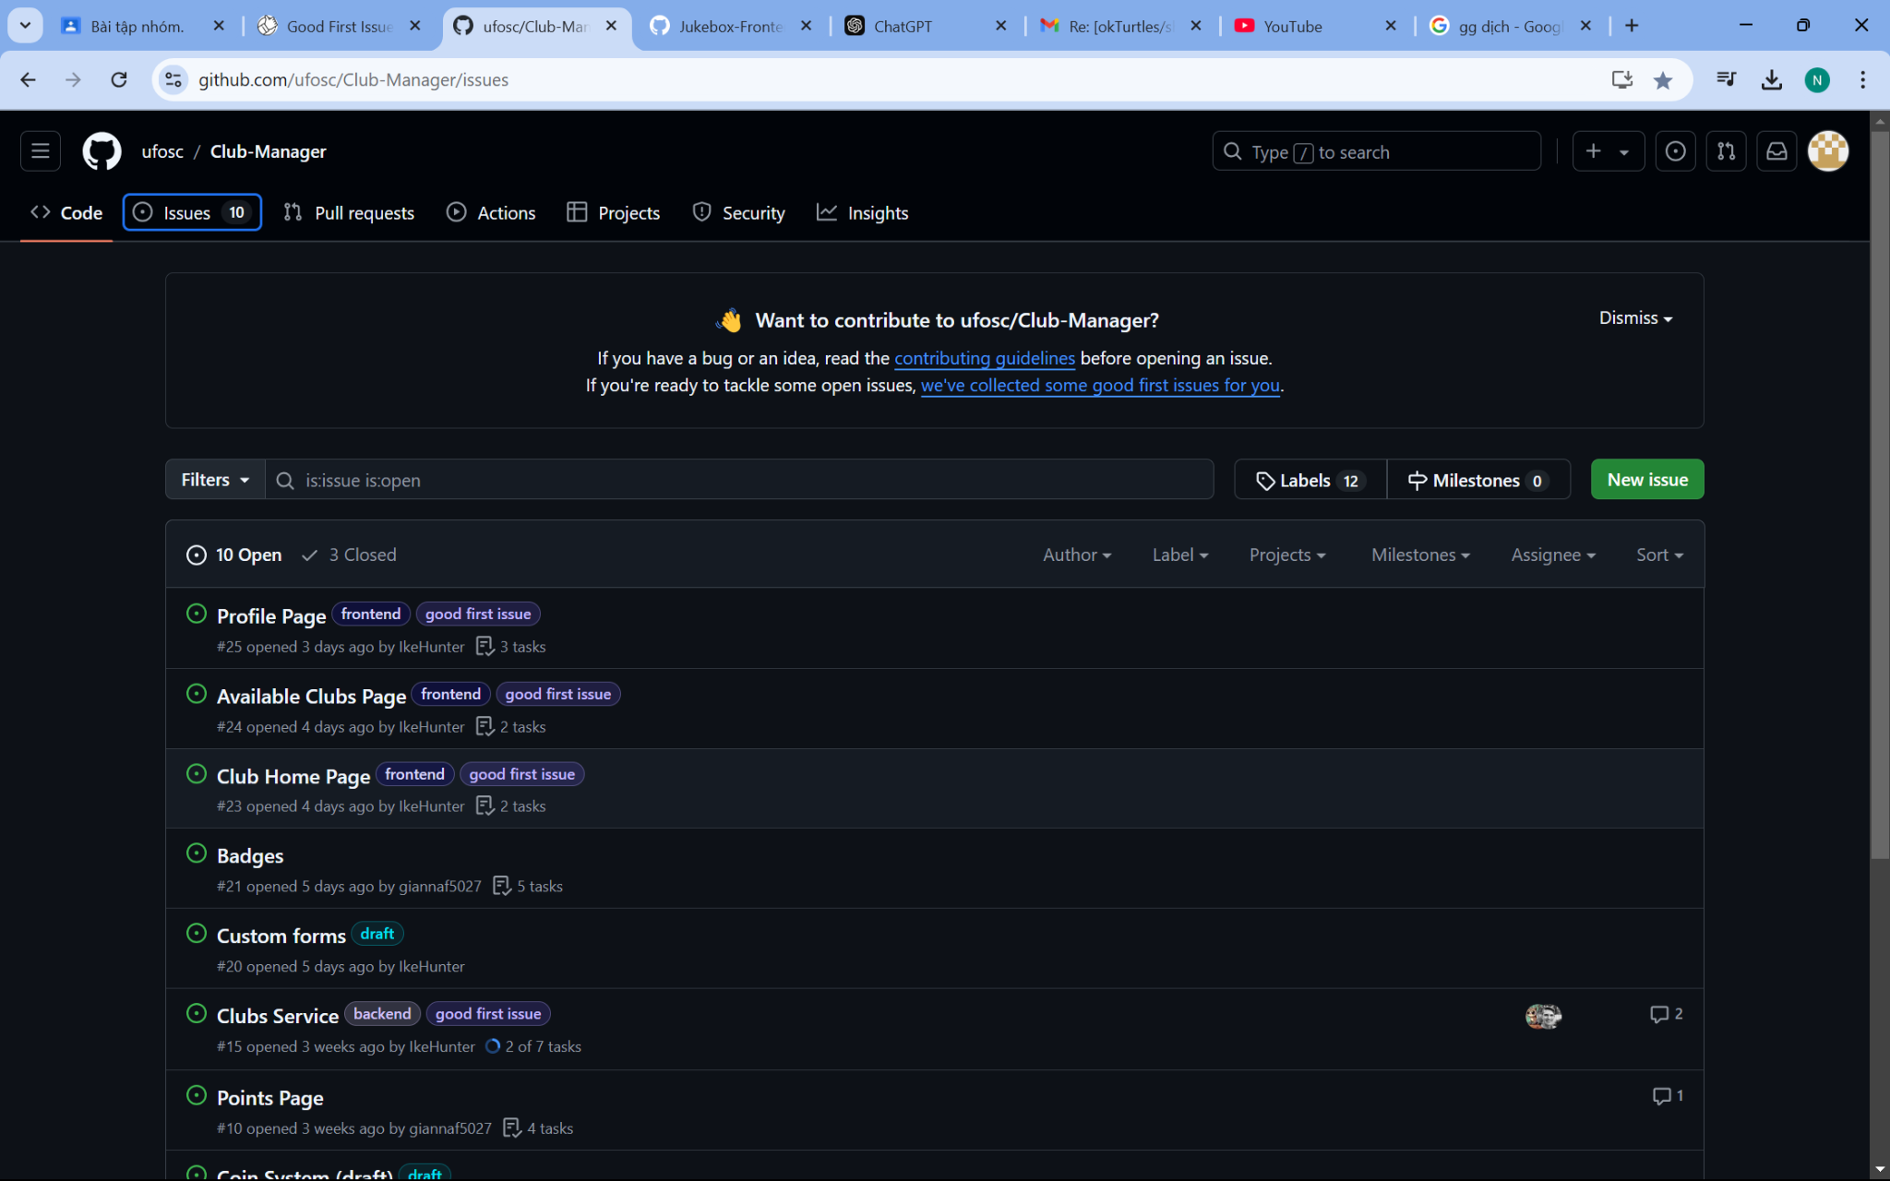
Available Clubs Page #24

Slide 30
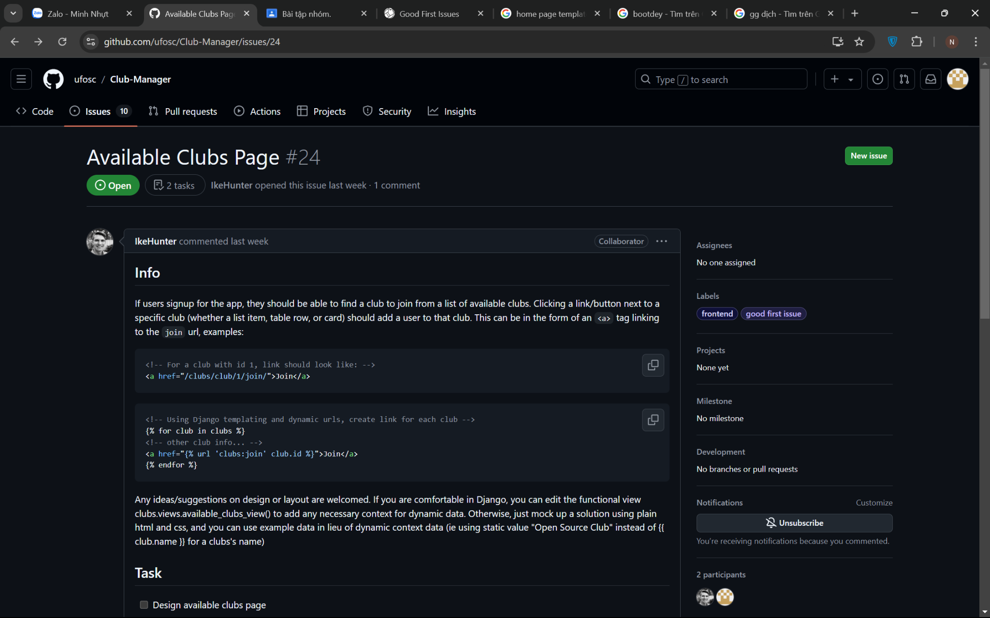
Available Clubs Page #24
Read the description of the issue

Slide 31
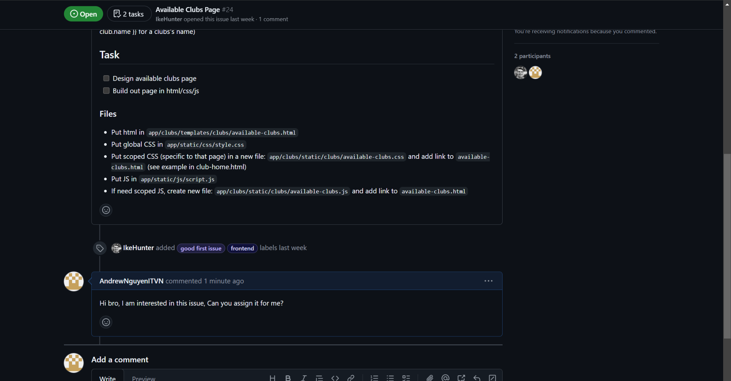
Available Clubs Page #24
Read the description of the issue

Slide 32
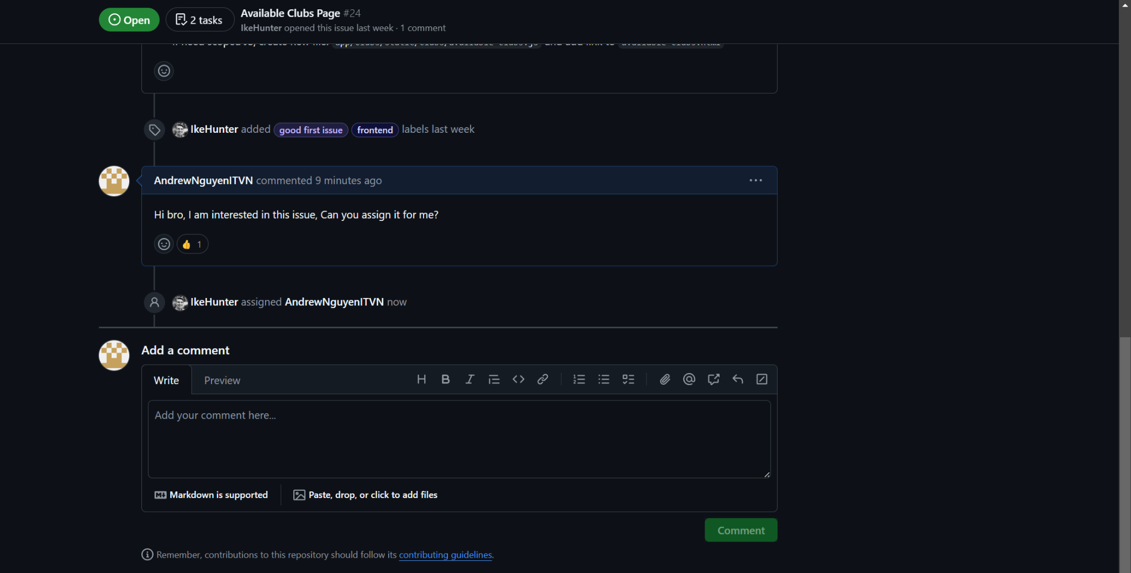
Available Clubs Page #24
Comment to request the assignment

Slide 33
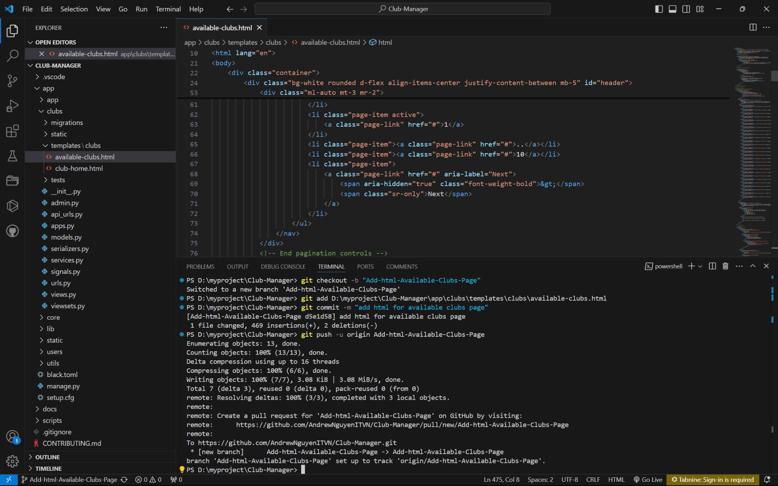
Available Clubs Page #24
Add content for the available-club.html based on requirement

Slide 34
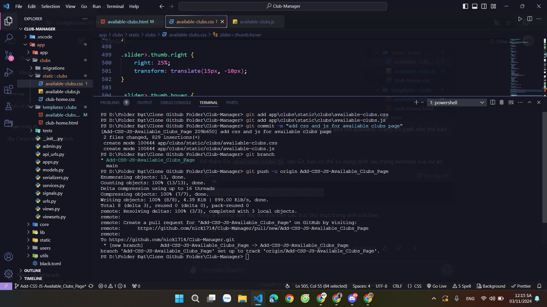
Available Clubs Page #24
Add CSS and JS for the available clubs page

Slide 35
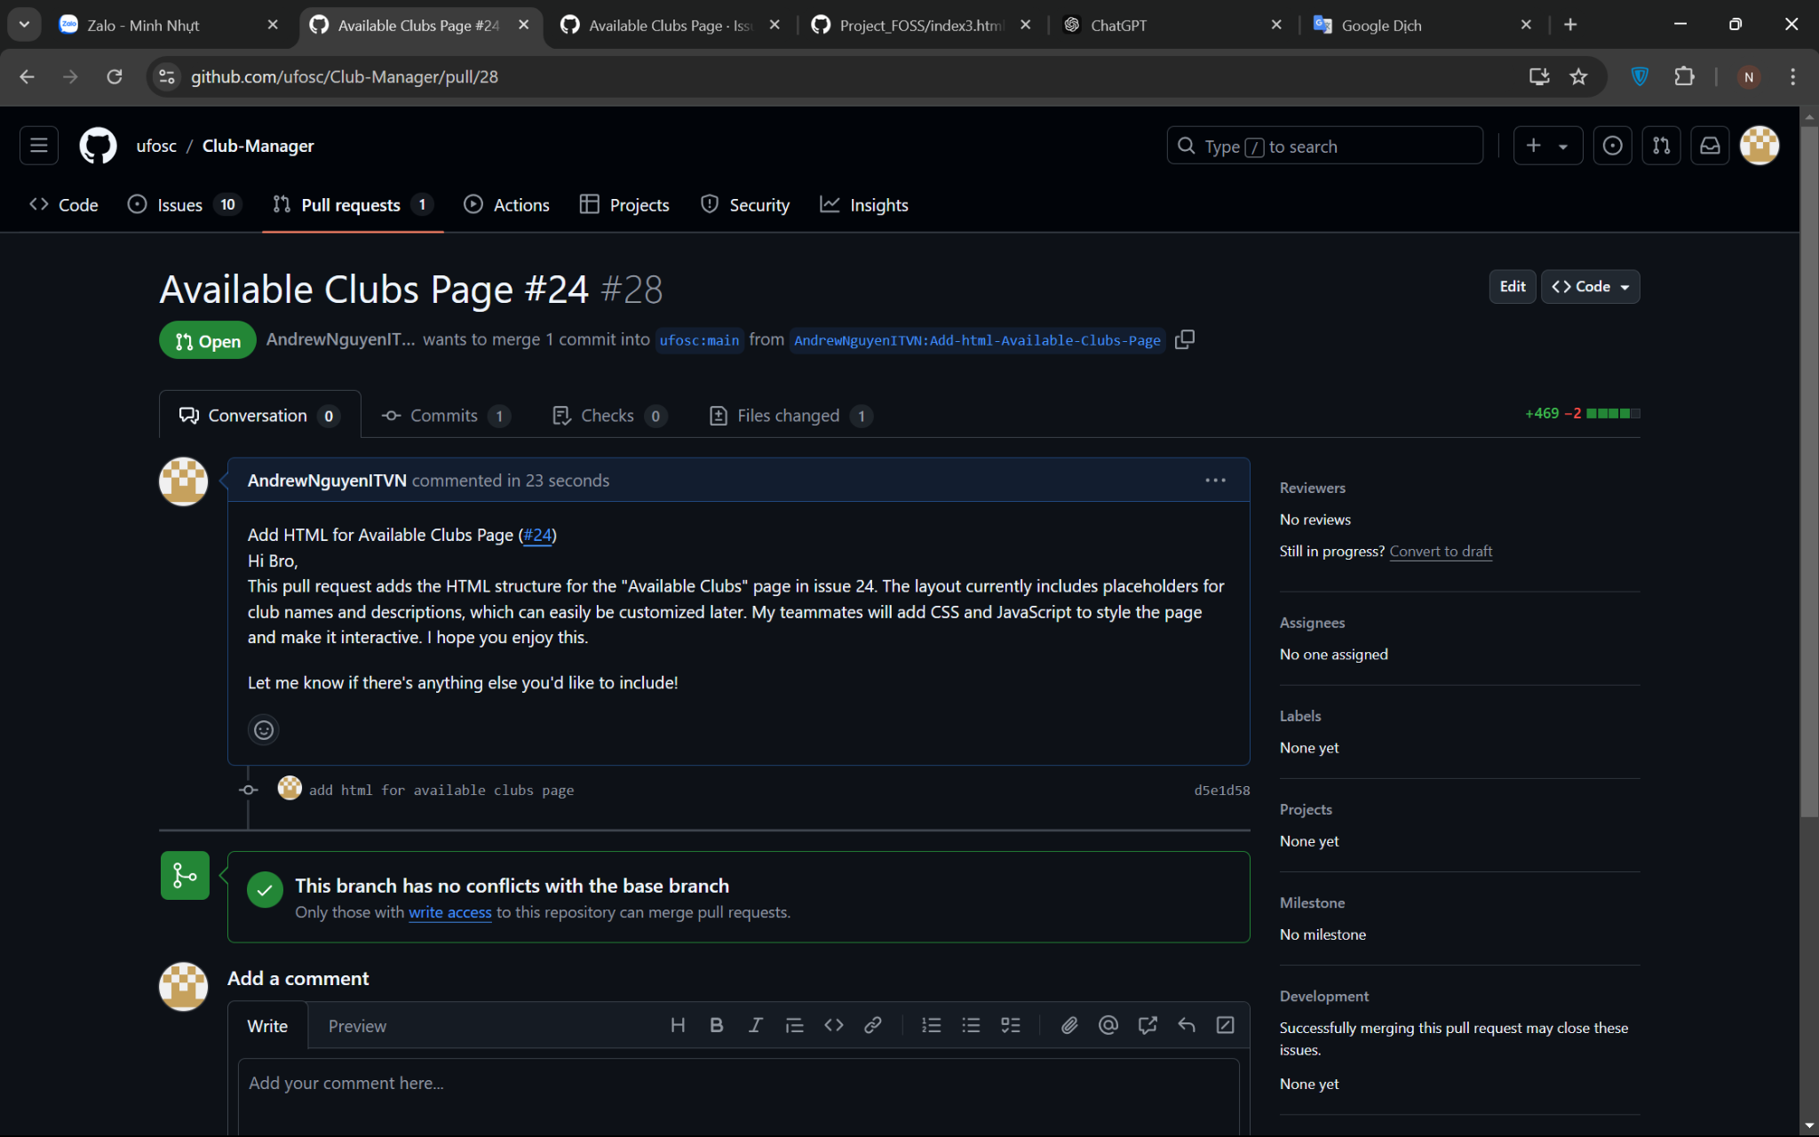
Available Clubs Page #24
Create a pull request for the maintainer

Slide 36
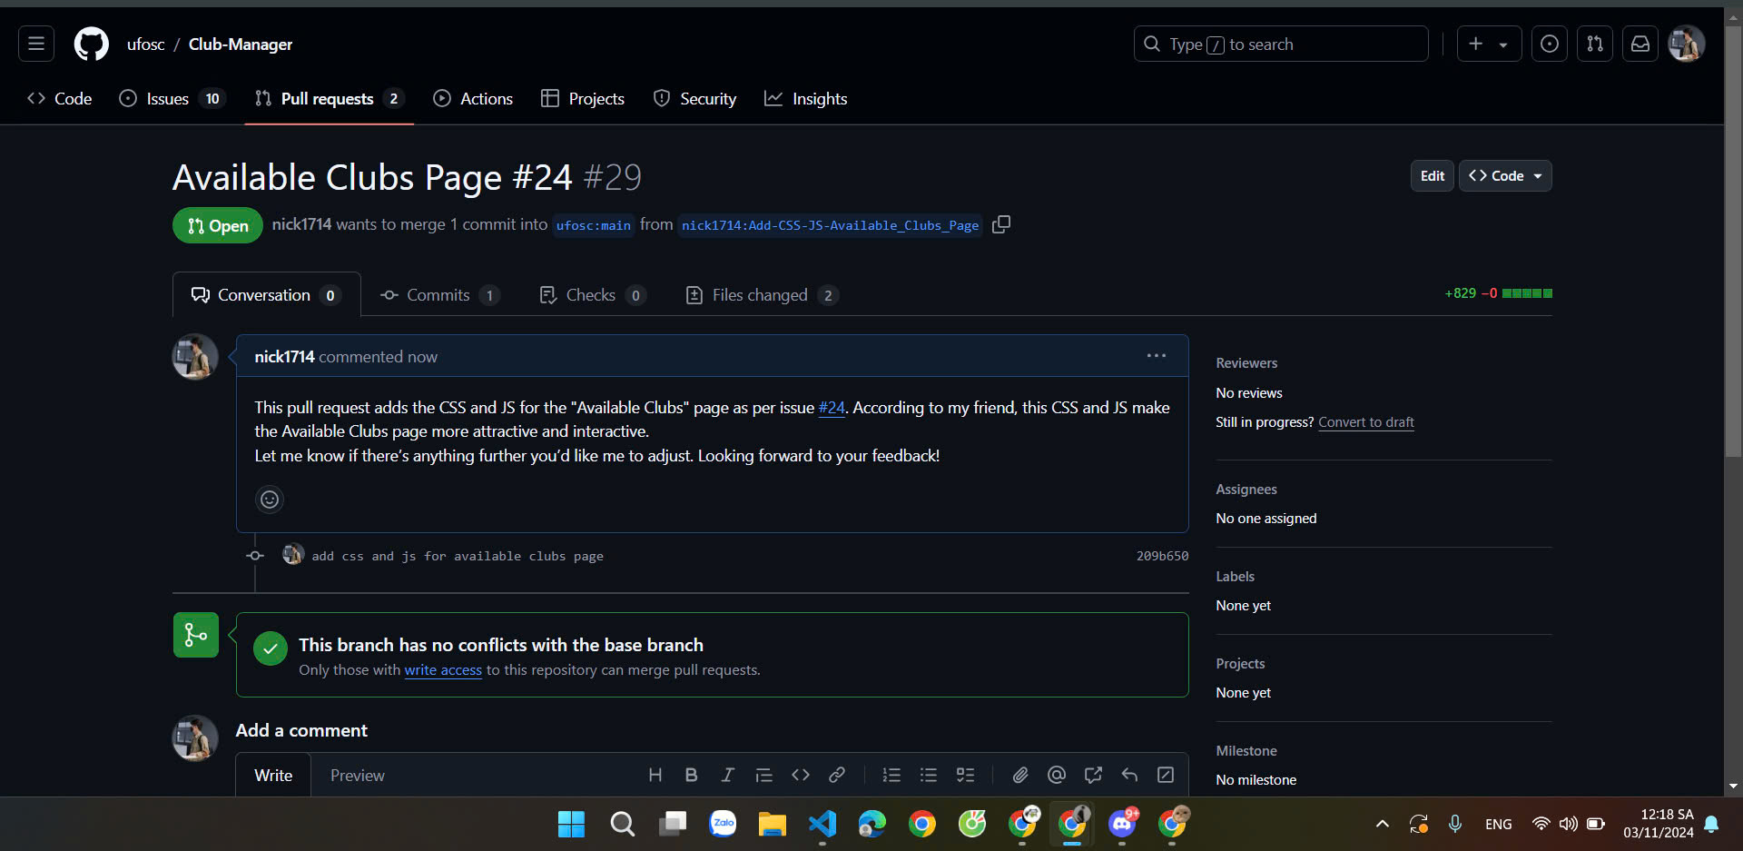
Available Clubs Page #24
Create a pull request for the maintainer

Slide 37
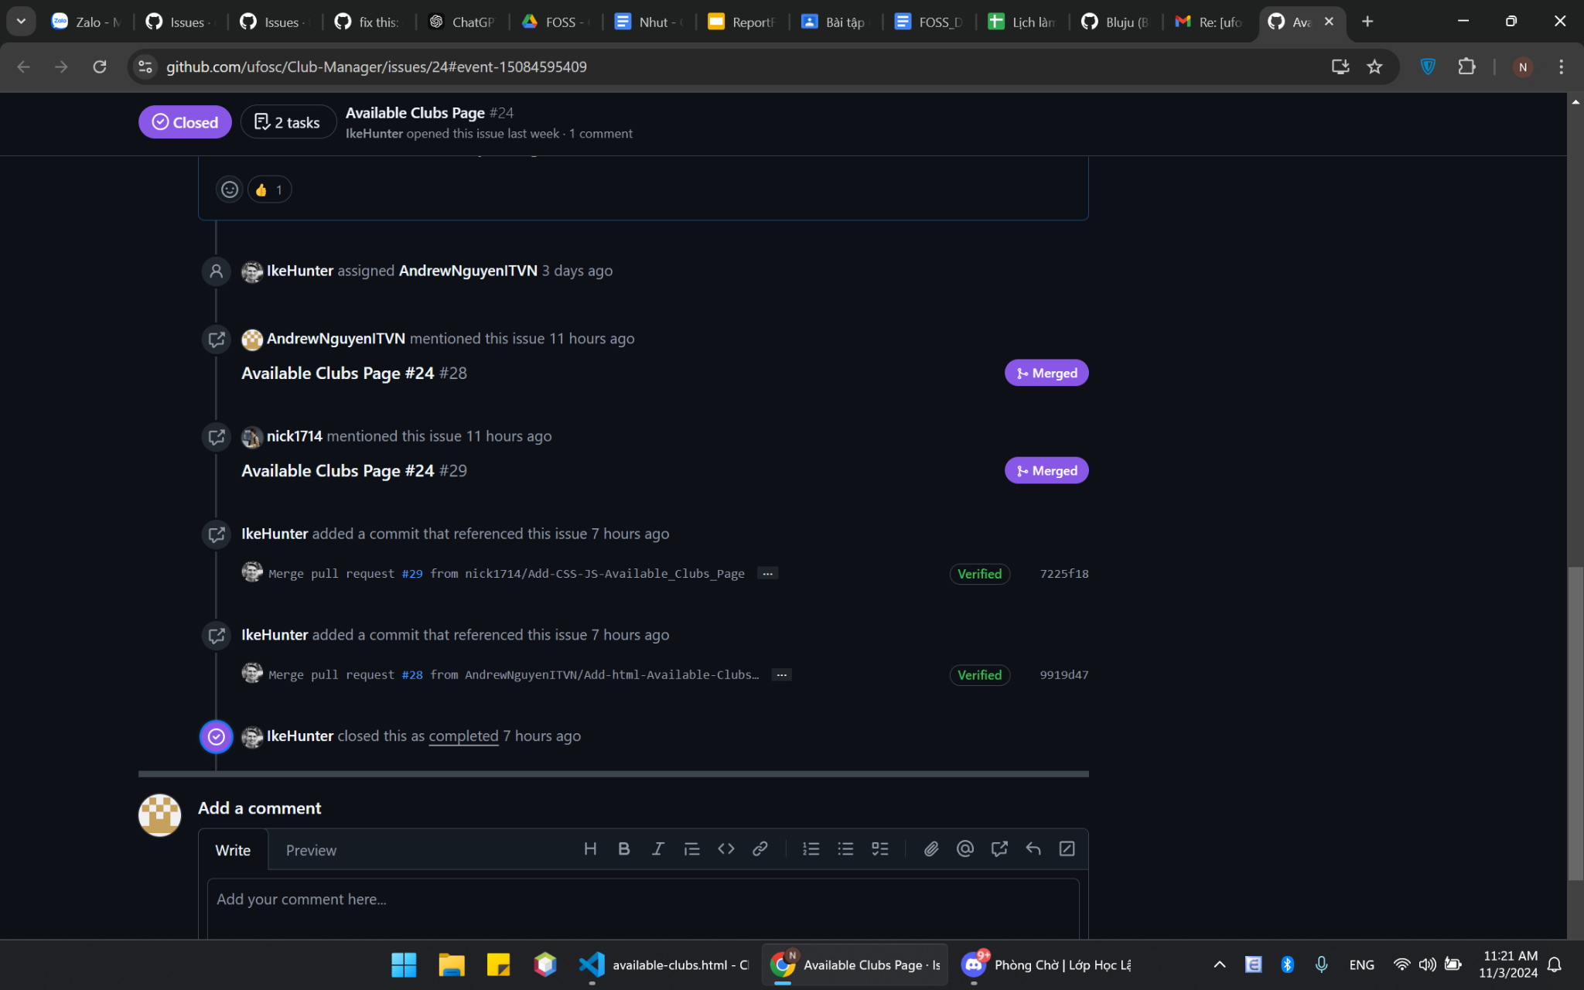
Available Clubs Page #24
Maintainer merged our pull request

Slide 38
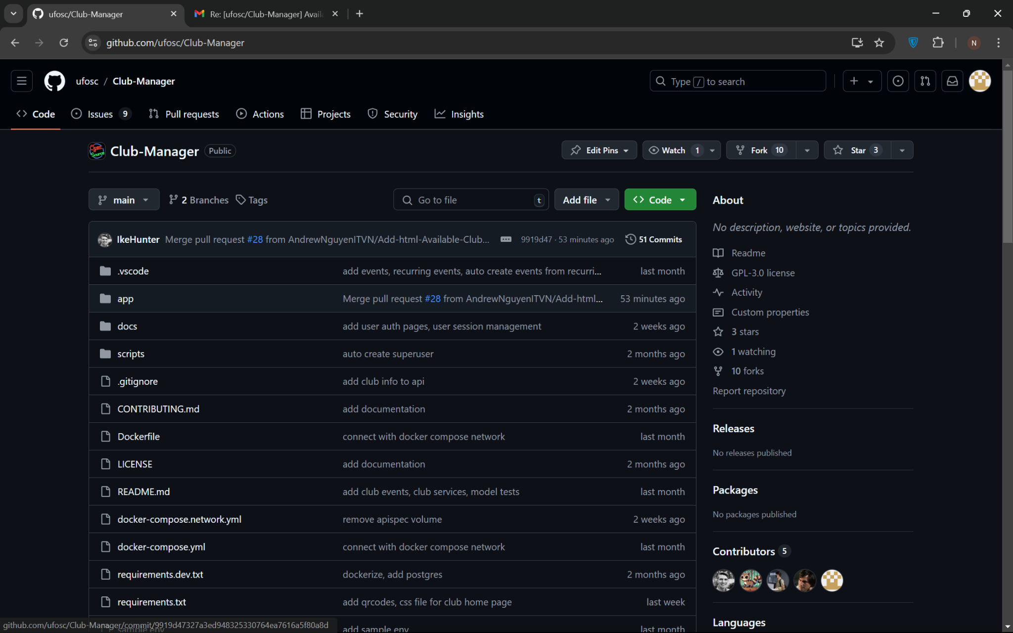
Available Clubs Page #24
We have become contributors to the project.

Slide 39
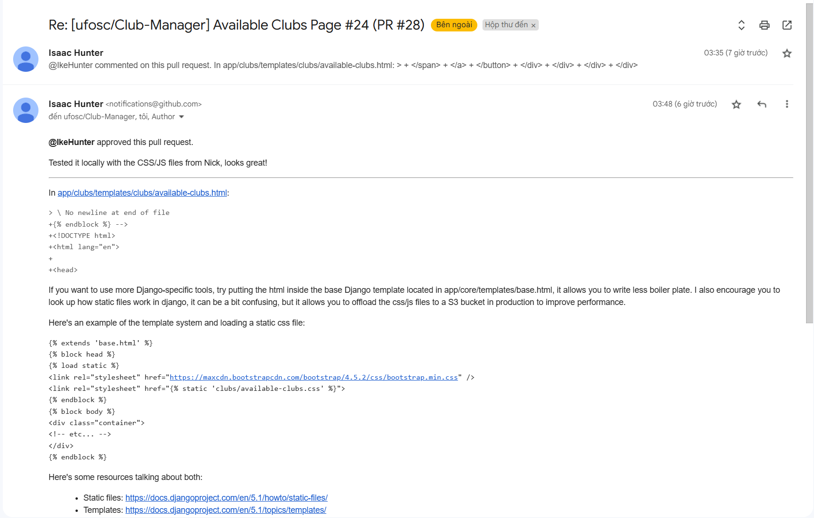
Available Clubs Page #24
The response of the maintainer

Slide 40
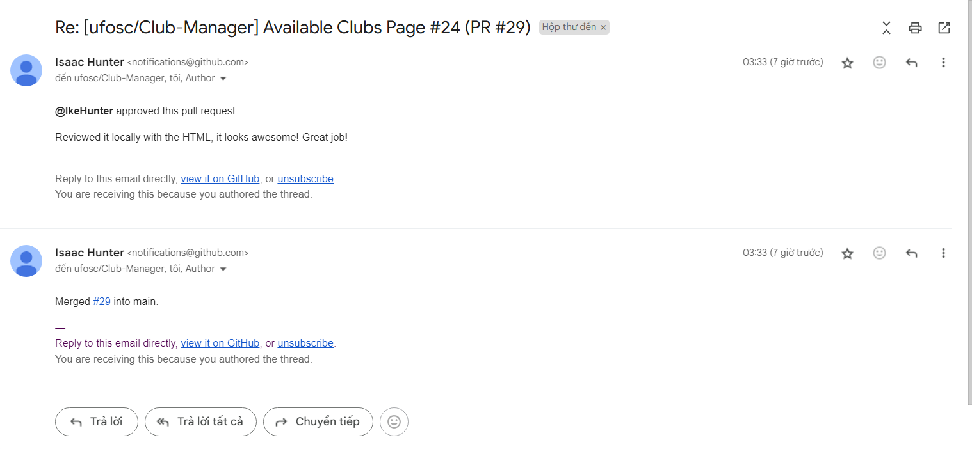
Available Clubs Page #24
The response of the maintainer

Slide 41
After Final Lab:
Developing Project Management Skills:
Learning how to break down tasks and prioritize them effectively.
Building Technical Knowledge Related to the open source project:
Becoming proficient with the specific technologies, frameworks, or libraries used in the project.
Developing debugging skills and learning techniques for code optimization.
Improving Communication and Collaboration Skills:
Communicating with other contributors to coordinate tasks and work as a team.
Learning to handle code conflicts (conflict resolution) when they arise on different branches.

Slide 42
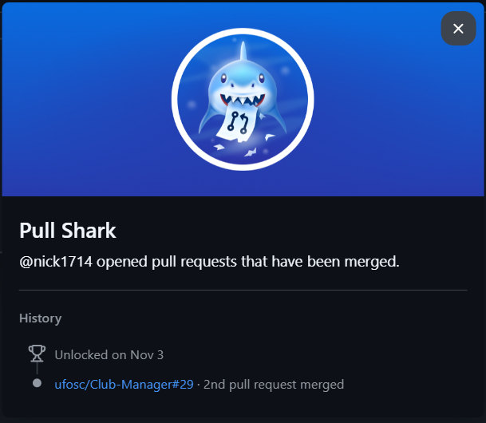
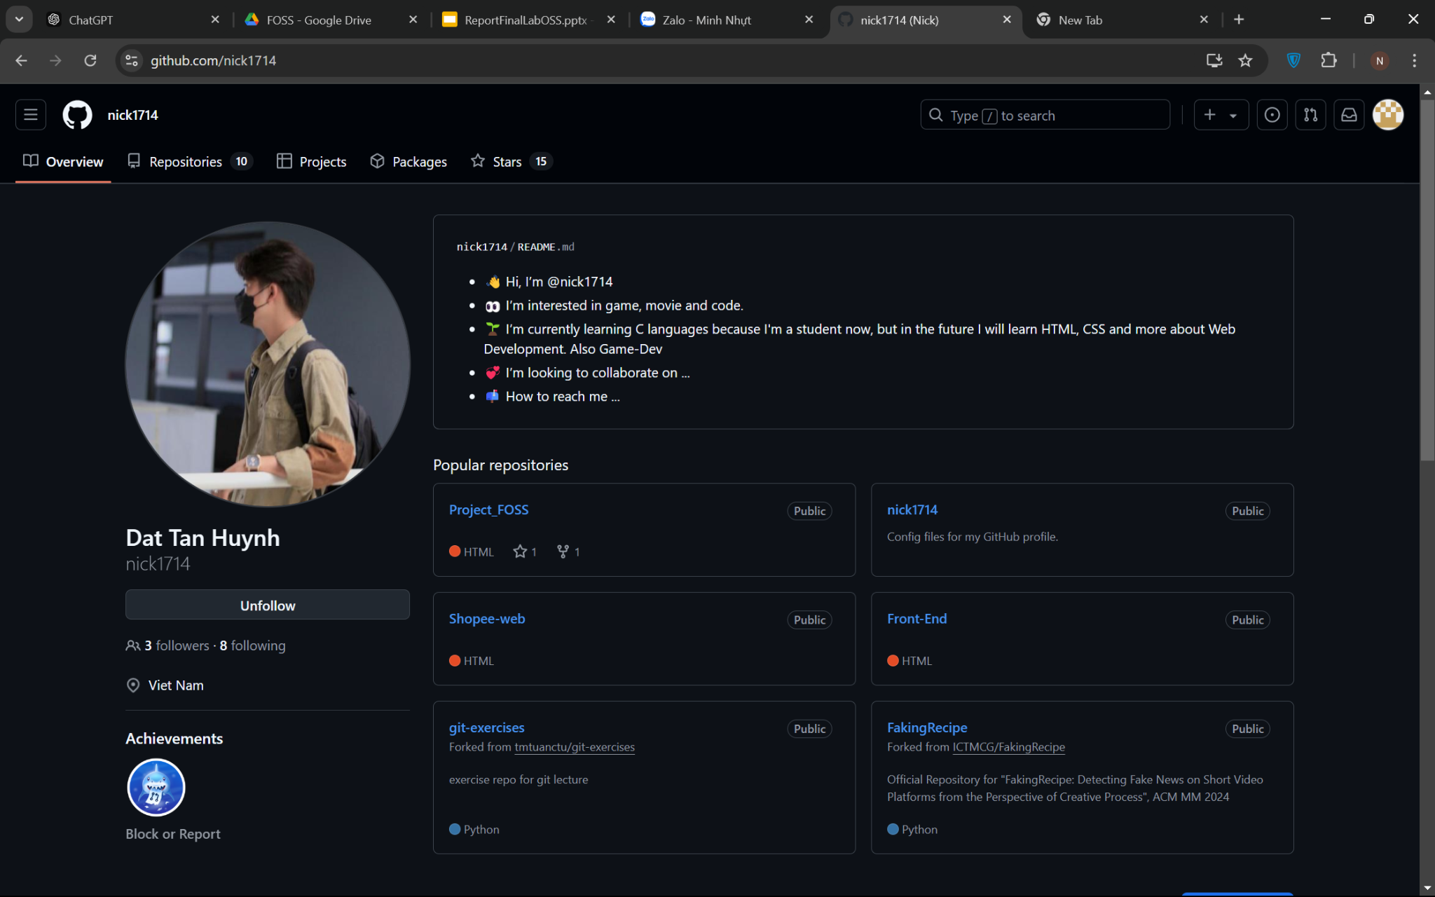
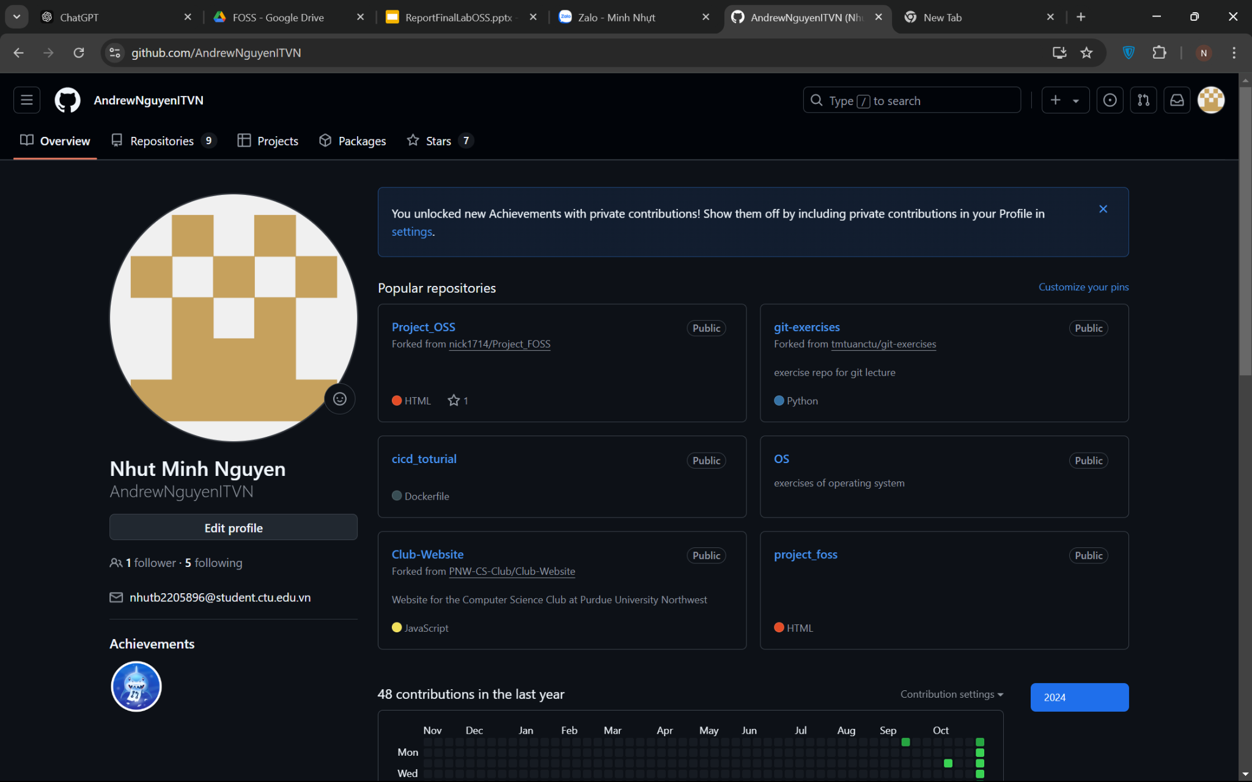
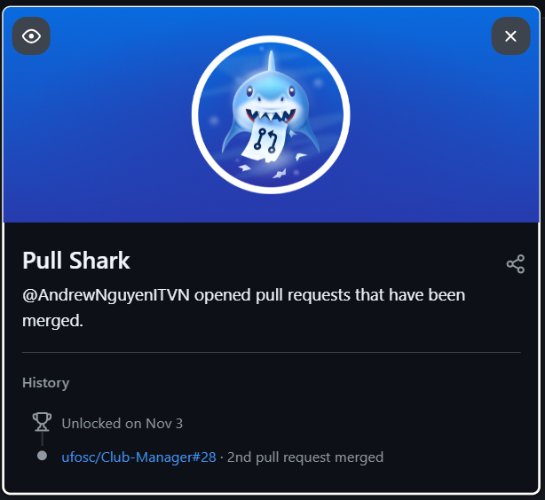
After Final Lab:

Slide 43
References
https://bbbootstrap.com/
https://slidesgo.com/theme/software-engineering-business-plan#search-technology&position-18&results-1169&rs=search
https://bbbootstrap.com/snippets/bootstrap-4-ecommerce-products-list-range-filters-89673127
https://bootdey.com/snippets/view/Shop-product-list
https://chatgpt.com/?model=auto

